Slide 1
Harnessing Technology For Improving The Quality Of Higher Education
By:-
Dinesh Badagandi
CEO, Varnaaz Technologies

Slide 2
Disclaimer
Type of Education Institute refer to
Pointers to Mythology

Slide 3
References and Source of data
Alder, M. J. (1982). The Paideia Proposal: An education manifesto. New York: Macmillan.
Angelo, T & Boehrer, J. (2002). Case learning: How does it work? Why is it effective? Case Method Website: How to Teach with Cases, University of California, Santa Barbara. http://www.soc.ucsb.edu/projects/casemethod/teaching.html
Balasubramanian N. & Wilson B. (2005). Games and Simulations. Retrieved April 15, 2009, from Society for Information Technology and Teacher Education: http://site.aace.org/
Benbunan-Fich, R. (2002). Improving education and training with information technology. Communications of the ACM, 45(6), 94-99.
Bonwell, C. C. (1996). Enhancing the lecture: Revitalizing a traditional format. New Directions for Teaching and Learning 1996 (67): 31–44.
Connolly, T. & Stansfield, M. (2007). From e-learning to games-based e-learning: using interactive technologies in teaching an IS course. International Journal of Information Technology & Management, 6(2-4), 188-207.
Davis, C. & Wilcock, E. Teaching materials using case studies. UK Centre for Materials Education, Higher Education Academy. http://www.materials.ac.uk/guides/casestudies.asp
Dorn, D.S., ‘Simulation Games: One More Tool on the Pedagogical Shelf’ Teaching Sociology, Vol.17, No.1, 1989, pp. 1–18.
Doyle, D., & Brown, W. (2000). Using a business simulation to teach applied skills - The benefits and the challenges of using student teams from multiple countries. Journal of European Industrial Training, 24(6-7), 330-336.
Faria, A. J. (2001). The changing nature of business simulation/gaming research: A brief history. Simulation & Gaming, 32(1), 97-106.
Gilgeous, V., & D’Cruz, M. (1996). A study of business and management games. Management Development Review, 9(1), 32-39.
Gredler, M. E. (1996) Educational games and simulations: A technology in search of a (research) paradigm. In, D. H. Jonassen (Ed.), Handbook of research for educational communications and technology (pp.521-540). New York, NY: Macmillan Library Reference USA
Hoffman, T. (2003). Simulations revitalize e-learning. Computerworld, 37(31), 26-27.
Holliman, R. & Scanlon, E. (Eds.). (2004). Mediating Science Learning through ICT. New York: RoutledgeFalmer. Retrieved April 15, 2009, from Questia database: http://www.questia.com
Kolb, D. 1984 Experiential Learning: Experience as the Source of Learning and Development Englewood Cliffs, NJ: Prentice Hall
Lainema, T. & Lainema, K. (2007). Advancing acquisition of business know-how: Critical learning elements. Journal of Research on Technology in Education (JRTE), 40(2), 183-198.
Moores, T., & Chang, J. (2001). Flowers for the world: Developing a business game to support the teaching of IS concepts. Proceedings of AMCIS 2001, Boston MA, Retrieved October 3, 2008, from http://aisel.aisnet.org/amcis2001/2
Morecroft, J. D. W. (1999). Visualizing and rehearsing strategy. Business Strategy Review, 10(3), 17-32.
Raymond, C., ‘Do Role-Playing Simulations Generate Measureable and Meaningful Outcomes? A Simulation’s Effect on Exam Scores and Teaching Evaluations’ International Studies Perspectives, Vol. 11, No. 1, 2010, pp.37-51.
Raines, S. S. (2003). The ISP Forum: Dialogue and debate (Vol. 4, pp. 432–433). New York: Wiley - Blackwell.
Roblyer, M.D. & Ekhaml, L. (2000). How Interactive are YOUR Distance Courses? A Rubric for Assessing Interaction in Distance Learning. Online Journal of Distance Learning Administration, Volume III, Number II. University of West Georgia, Distance Education Center. Retrieved April 15, 2009, from: http://www.westga.edu/~distance/roblyer32.html
Sfard, A., ‘On Two Metaphors for Learning and the Dangers of Choosing Just One’ Educational Researcher, Vol. 27, No. 2, 1998, pp.4-13.
Stolk, D., Alexandrian, D., Gros B., & Paggio R. (2001). Gaming and mult imedia applicat ions for environmental crisis management training. Computers in Human Behavior, 17(5-6), 627-642.
Will Thalheimer, (2003), How simulation like questions can help replace expensive multimedia simulation, Presented at ASTD TechKnowledge. http://www.uwex.edu/disted/conference/Resource_library/proceedings/03_15.pdf

Slide 4
Answer yourself ?
In a typical tier two B-School how many students are attentive in class?
Are the students compelled to attend classes or they attend with their interest?
How many Students who were attentive in class have really succeeded in their career

Slide 5
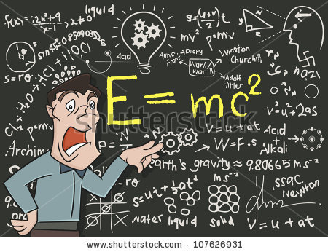
Current Management Education System
Passive Learning

Slide 6
Did you ever teach your students to use social media?
Have you ever felt your kid is smarter than you?

Slide 7
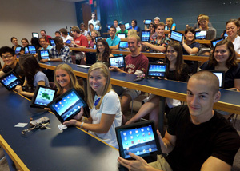
Students love technology

Slide 8
Internet Usage
India's internet
2% - Number of rural Indians using the internet
25% - Growth in Indian internet users in India over the past 12 months.
59% - Number of Indians who only access the internet via mobile devices.
Source: wearesocial.sg

Slide 9
Simulation
Imitation of the operation of a real-world process or system over time.

Slide 10
Simulation Learning in Mythology

Slide 11
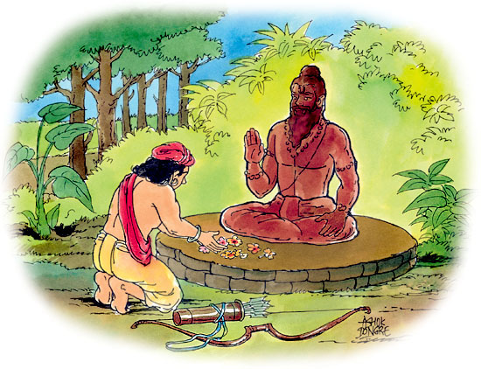
Simulation Learning in Mythology

Slide 12
Where do we find simulated learning?

Slide 13
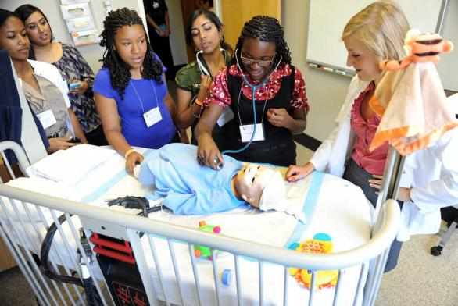
Simulation in other Fields
Medicine

Slide 14
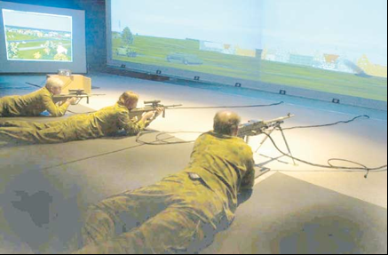
Simulation in other Fields
Military Weapon Training

Slide 15
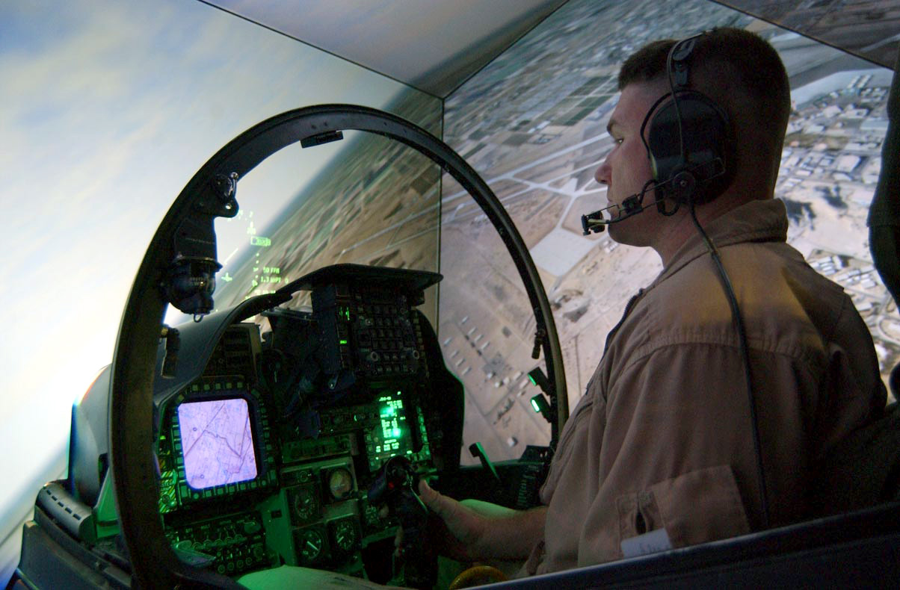
Simulation in other Fields
Aeronautics

Slide 16
Why not in Management?

Slide 17
Bringing Biz Simulation into the classroom

Slide 18
Data Source for design of methodology
Collection of data through primary source
Using e-panel discussion
http://www.linkedin.com/groups?search=&answerCategory=myq&gid=3000704
14 academicians and dynamics professionals who are part of DYNAA (DynAA group in LinkedIn) participated in discussion
Feedback from students

Slide 19
Methodology adopted for Training
Signed up with a Microsoft Dynamcis Academic Alliance Program
Installed Microsoft Dynamics NAV in Lab
ERP Business consultants conducted a training program for 72 hours
Feedback was collected for every 8 hours of delivery

Slide 20
Methodology
ERP Games
Theory Classes
Practical Classes
Case Study
SME Conclaves
Industrial Visits
Assignment, Quizzes and Online Exams

Slide 21
ERP Game (Day 1)
Discussion on individual’s dream job
Understand the roles and responsibilities of their dream jobs
Divide class into 5 groups each representing as a department of a hypothetical company
Like (Purchase and Warehouse, Sales, Finance, Human Resource, Manufacturing)
Discussion on case study (P C Solutions Ltd.)
Identify factors affecting a business enterprise
Internal factors
External factors

Slide 22
ERP Game (Day 2)
Provide the groups with a task to complete as a team
Add complexities or challenges during the task in progress
Realize the importance of information in dealing with the challenges
Realization of Importance of ERP in completing the task

Slide 23
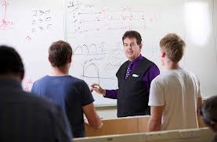
Theory Classes

Slide 24
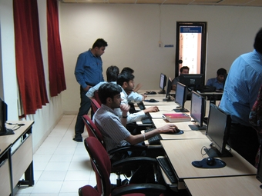
Practical Classes

Slide 25
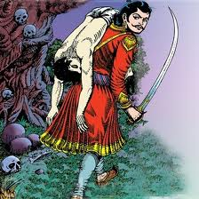
Case Study

Slide 26
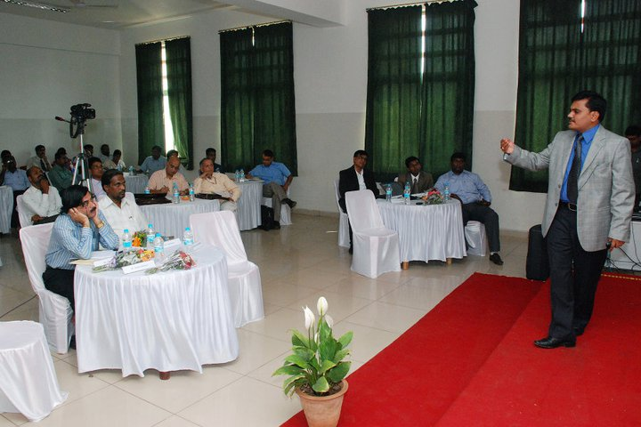
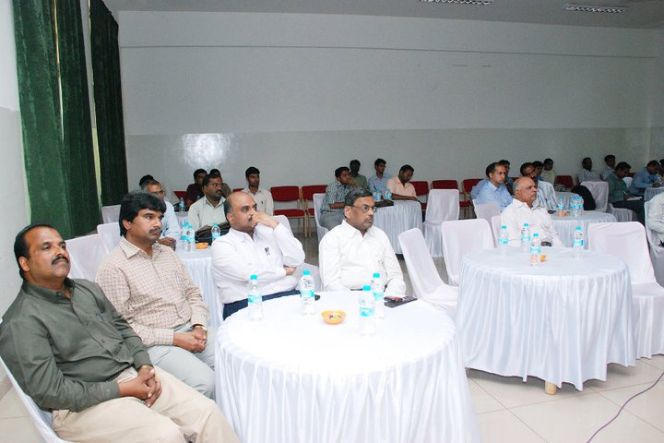
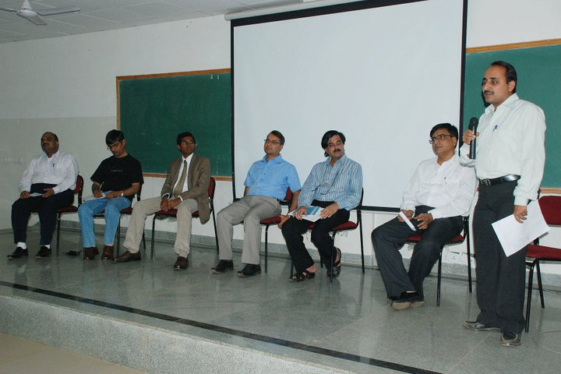
SME Conclaves

Slide 27
Industrial Visits

Slide 28
Assignment, Quizzes and Online Exams

Slide 29
Sample Survey
Total number of batches – 3 batches
Batch 1 – ERP program was introduced as a value added program
Batch 2 - ERP program was introduced as a value added program
Batch 3 – ERP program was added into the curriculum which is spread across 2nd and 3rd Semester
Course was based on Modules of ERP
Finance
Trade & Logistics
Human Resource

Slide 30
Outcome of Academic Alliance Program

Slide 31
Outcome of Academic Alliance Program
20% jump in Placement
100% students who joined jobs leveraging this continue with same domain
Increase in Students’ class-participation
Students were able to understand the interconnection between the business processes of an organization
Gain confidence to take managerial decisions in their future jobs
Ability to think in multiple dimensions to solve a business problem

Slide 32
Conclusion
Complementing activities with the lecture session
Case studies
Quizzes
Assignments
Projects
Bring participatory learning into the classroom

Slide 33
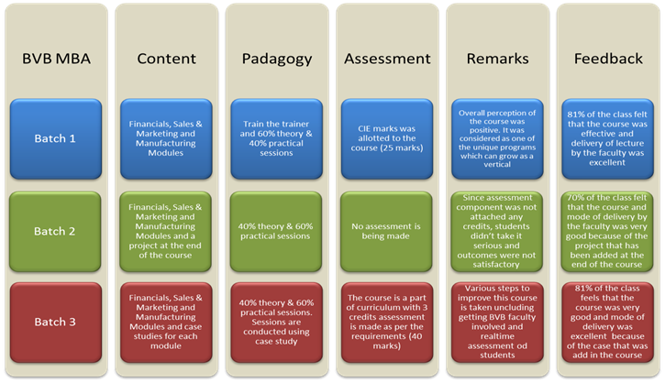
Conclusion

