Slide 1
Sure Step Case Study in the Classroom
2012 Edition
Mike Canniff
University of the Pacific

Slide 2
Topics
Sure Step in the Classroom History
Existing Issues
AIS 2012 Changes
Room for Improvement
Panel Discussion

Slide 3
In Search of a Case!
Longstanding Desire to Have a Standardized Case for MIS, AIS, and MBA curriculum
2009-2010 = Case Competition Idea
FitterSnacker Model
2011 = Sure Step Pilot
2012 = Case Refinement

Slide 4
2010-11 Sure Step Pilot
Initiated by Microsoft Sure Step Team
Modeled after Tailspin Toys and Trey Research
Participating Schools
Augusta State University
University of Indianapolis
University of the Pacific
Western Michigan University
High “Touch“ Model

Slide 5
Typical Case Scenario
Students Installed Sure Step
Imported the Tailspin Toys Documents
Students Reviewed Microsoft Sure Step training material
Group Assignments
Trey Research
Tailspin Toys
Developed Presentations
“Winning the Business”
Project Implementations

Slide 6
Existing Issues
ERP Implementation is Complex
Tough topic for undergraduates and non-MIS students
Most classes do not have time to devote to this topic
SureStep is Complex
Hundreds of templates
Multiple project implementation styles (Agile, SDLC, etc)
Partner Orientation (not student)
Tailspin Case Overwhelming
Students given artifacts from fictional meetings
Open Ended deliverables
Supplemental case material not well organized

Slide 7
UOP AIS Class Overview
Student Makeup = 90%+ Accounting Seniors
Business Process Focus
Revenue, Expense, Capital Business Cycles
Students Use Dynamics GP and run a company for 1 period
Students maintain their own DB
Sure Step Course Project = 16% of grade
Two Class sessions devoted to ERP Implementations
Microsoft Sure Step training provided (http://dynamics.microsoftelearning.com )

Slide 8
Changes Implemented for 2012
Updated story line to fit more of an educational case study (Harvard, Ivey)
Integrated more with ERP Implementation Topic
Removed the role play switch as part of original case
Updated case roles
Students will assume specific team member personas
Assigned specific tasks to each persona
Renamed personas to be gender neutral
Provided student time line for deliverables
Surestep Installation is Optional
Leverage Sharepoint for Documentation

Slide 9
AIS Project Introduction
Trey Research – Microsoft Dynamics Partner
You will assume a project team role
Engagement Manager
Project Manager
Application Consultant
You are in charge of implementing a Microsoft Dynamics ERP
Tailspin Toys – Specializes in the worldwide distribution of children's toys.
As a member of the customer team, you will represent the needs of your company
Business Decision Maker
End User
IT Manager

Slide 10
Trey Research Member Roles and Tasks
Engagement Manager
Lead requirements presentation and present the objective, scope, wrap up/conclusions
Complete costing worksheet
Project Manager
Present review process, activities, findings
Create project plan
Coordinate team meetings for Trey research
Technical Consultant/Application Developer
Complete the Performance Review and findings document.
Help with flowcharts for Sales, Procurement, and Finance processes from narrative
Application Consultant
Present critical issues, non-critical issues, next steps
Help engagement manager with costing worksheet
Create flowcharts for the Sales, Procurement, and Finance processes from narrative

Slide 11
Tailspin Toys Team Member Roles/Tasks
Alex Carter (CEO)
Lead Kick Off meeting and present the agenda, intro background, project overview, scope, facilities, conditions,
Coordinate the Tailspin team meetings, schedules, etc
Bobby King + Shawn Richardson
Present key deliverables, team structure, organization, roles, communication,
Create flowcharts for Sales and Purchasing
Loren Nash
Present out of scope slide, time line, methodology, project mgmt, sign off and approvals, next steps
Complete technical architecture spreadsheet
Kelsey Houston
Select Trey research team.
Create flowchart for finance process.

Slide 12
Class Project Schedule
Review Docs and Training
Team Meeting and Assign Roles
Complete individual assignments
Build out deliverables
Schedule meetings with Instructor and/or Tailspin
Final Presentations
April 2 Class Session
April 25 Class Session
|------------- March -----------------|-------------- April --------|

Slide 13
Student Next Steps
Read SureStep documents in order located in Sharepoint
Review training modules located on Microsoft Customer Source
Assign roles on Team
Each person has specific deliverables
Decide which activities you want to lead
Optional
Download and Install Sure Step
See Sakai → Resources for installation
Review standard templates

Slide 14
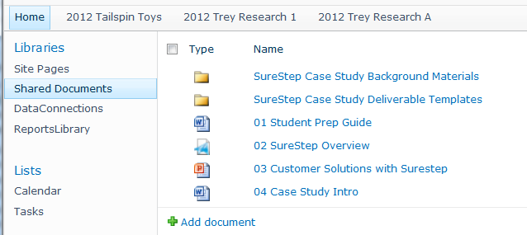
Sharepoint Site for Teams
Team Specific Sites with Security
Exported SureStep Documentation
Documents Identified with Sequence Numbers

Slide 15
Improvement Still Needed!
Increase the Narrative of the case
Provide more background of the team players and Tailspin issues
Create an in class case discussion session
Focus on “pain points”
Need access to hosted SureStep application
Allow for more hands on usage
Simplify artifacts in the case even more
Stretch Goal
Expand to other implementation Phases

Slide 16
Panel Discussion

