Slide 2
Integrating GP Payroll into Accounting Information Systems Class
Academic Alliance Pre-Conference : Business Decision Making Track
Mike Canniff
MIS Faculty
University of the Pacific

Slide 3
Topics
Background and Motivation
Curriculum Details
  Business Process Pedagogy
  GP Requirements
Future Enhancements

Slide 4
What was I Thinking???
History
  ERP Course within MBA Program 2003-2006
    Covered All Aspects of ERP
    Very Light on Accounting Content
  AIS Course 2007-2009
    Focused on Primary Accounting Modules (GL, AR, AP)
    Covered Human Resources/Payroll at High Level
Goals
  Introduce Students to Detailed Accounting Related Transactions within Payroll
  Explore Dynamics GP Payroll
  Add to Course Lab Sequence

Slide 5
Typical AIS Pedagogy
Based on Text Book Reviews
Text Book Allocation
  25% Devoted to Audit and Control
  20% Devoted to System Development and Documentation
  20% Database Modeling
  15% Traditional Accounting Functions (GL, AP, AR)
  5% Manufacturing
  5% Human Resources and Payroll
Training Material Focus
  Primarily on Core Financials

Slide 6
Silo Based Instruction
Expenditure
Cycle
Revenue
Cycle
General Ledger
and Reporting
System
Commissions
Human Res./
Payroll Cycle
Production
Cycle
Payroll Dr/Cr
Labor
Funds
Financing
Cycle

Slide 7
Existing AIS Lab Scope
Lab Scenario
  Adopted from Kim’s Flower Shop (small Retail company)
  Stacy Kovar, Kansas State University
Lab Sequence
  GL Setup
  Order Management
  Procurement
  Billing / AR
  Accounts Payable
  Period End Closing and Reporting
Lab Environment
  Single MS SQL Server environment
  Running on Virtual Machine
  Each Student is Assigned their own DB

Slide 8
Topics
Background and Motivation
Curriculum Details
  Business Process Pedagogy
  GP Requirements
Future Enhancements

Slide 9
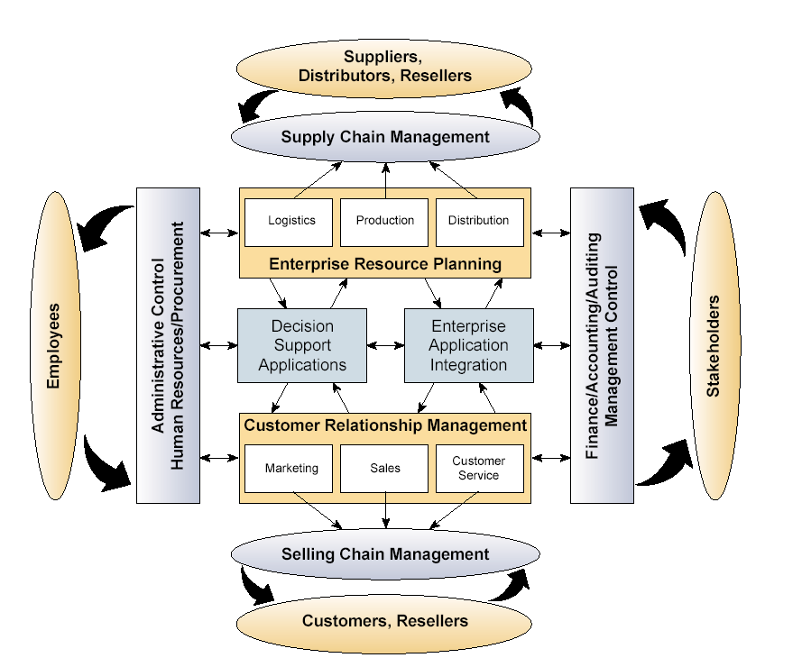
High Level ERP Functions

Slide 10
Human Capital Management
Definition
  Hiring, developing, assigning, and retaining employees
Why do Accountants Care?
  Estimates value of human capital > $500,000 per person
  Average cost of replacement is 1.5 times the employee’s salary.
  Company costs represent 43% of operating expense
  Employee Value = job-related knowledge, skills, and motivation
  Much of HRM is NOT captured by GAAP – Accounts need to recognize implicit value
Trends
  Self Service, eHR (automation)
  Workforce
    graying workforce
    virtual teams
    telecommuters
    Consultants and contractors
    part-time and temporary employees

Slide 11
Human Resource Processes
Hire to Fire
Applicant
Deploy
Hire
Employee
Develop
Enterprise Management
HR
Recruit
Pay
Identify
Person (Workers, Dependents, Beneficiaries)
Retire
Rehire
Retiree

Slide 12
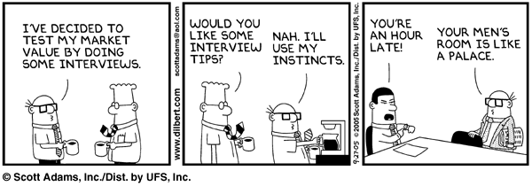
Recruiting Components
Recruit Workforce
  Part of Human Resources product
  Applicant tracking functionality
eRecruit
  Self Service for Employees and External Applicants
Wally Looks for a Job!
Notes:
Recruit workforce is a module within the HR application that customers get when they license HR. This module supports all applicant tracking functionality and is heavily integrated with the rest of the solutions identified on this slide.
The resume Processing product, supports organizations processing resumes from paper, faxes and email.

Slide 13
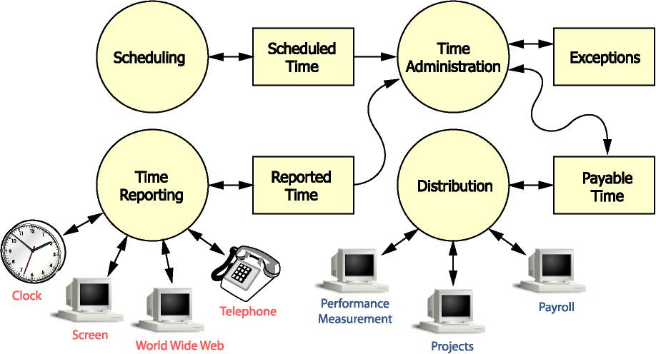
Time and Labor Processes
Notes:
Task reporting & project costing
Wide range of time collection options
Central repository for all the time related data
Roles based user experience
One repository of true data available across the enterprise

Slide 14
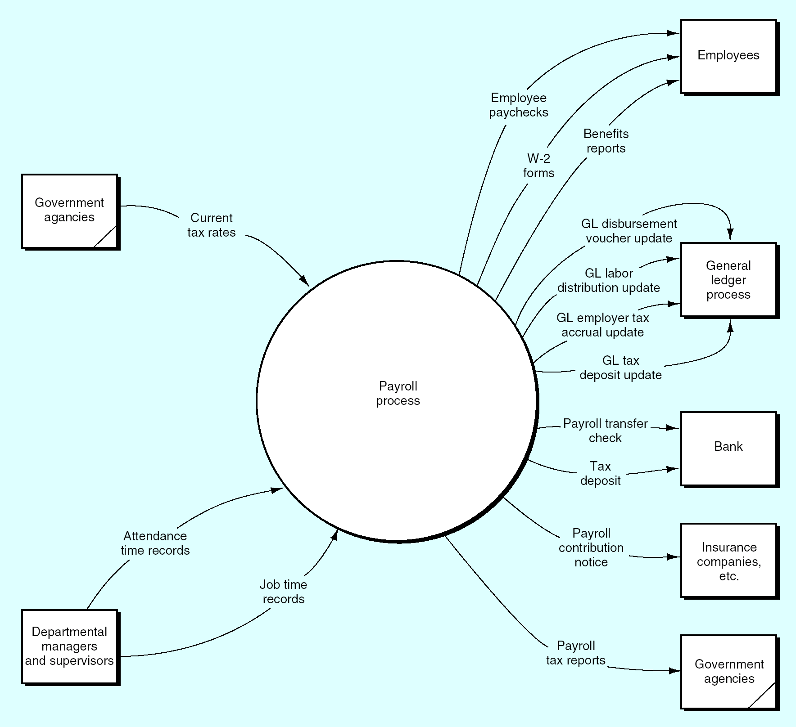
Payroll Process Data Flow Diagram
Context Level

Slide 15
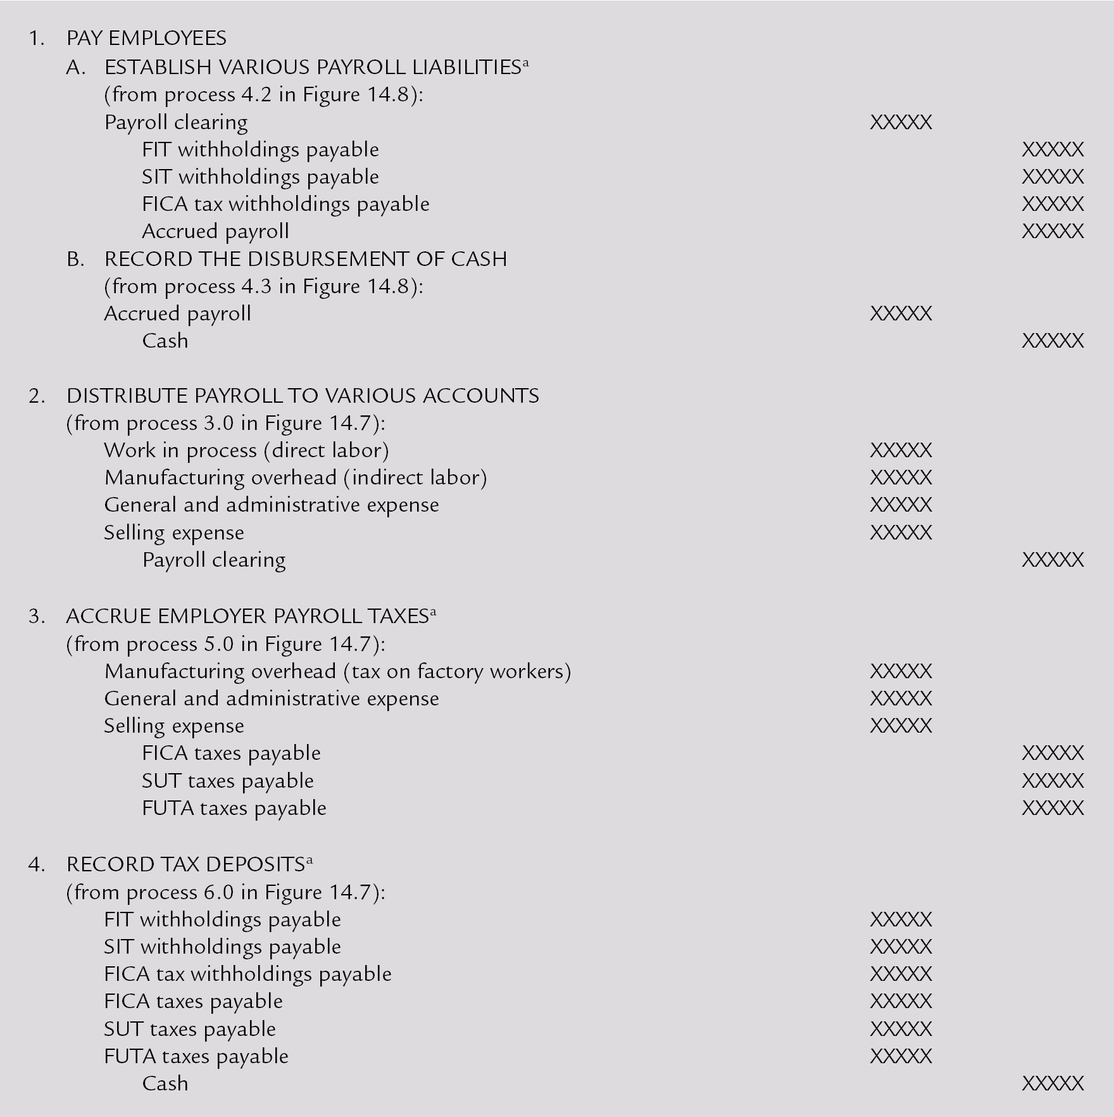
Accounting Entries in Payroll

Slide 16
Payroll Has High Fraud Potential
Types of payroll frauds:
  Ghost employees
  Falsified hours
  Commission schemes
  Worker’s comp schemes
  Expenses Fraud – Altering receipts, personal expenses
Payroll Controls
  Segregation of duties between HR (employee record creation), payroll (prepares payroll) and AP/cashier (disburses cash)
  Direct deposit (eliminates opportunity for check fraud)
  Review of employee master data for duplicate names and/or social security numbers
  Comparison of actual payroll to budget
Notes:
Ghost employees (employees who don’t exist but are issued paychecks)
Falsified hours (employees who overstate hours worked)
Commission schemes (collecting commissions on false sales or using false commission rate)
Worker’s comp schemes (faking injury to receive compensation)
Reimbursement for employee business expenses often clear the payroll system
Claiming personal expenses as business related
Altering receipts to increase expenses
Submitting false receipts
Submitting same expense multiple times

Slide 17
Topics
Background and Motivation
Curriculum Details
  Business Process Pedagogy
  GP Requirements
Future Enhancements

Slide 18
Payroll Lab Details
Assumptions
  Single Hourly Employee
  No Medical Benefits
  Deduct only Federal Taxes
  Default Hours Worked
Payroll Lab Sequence
  GL Account Definition
  Payroll Setup
  Hire Employee and Assign Pay Codes
  Run Payroll
  Print Checks
  Post to GL

Slide 19
Payroll Installation Note
Request Payroll License Key from MSFT AA
  Login to Server
  Navigate to Dynamics GP → Tools → Setup → System → Registration
  Update License Key
Restart Dynamics
  You will be prompted to download the latest Payroll tax updates
  Proceed with tax installation

Slide 20
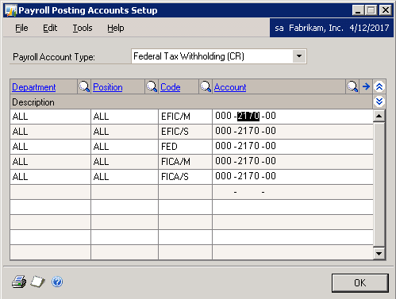
GL Setup for Payroll
Required Accounts for Payroll

Slide 21
Other Payroll Setup
Definitions
  Departments
  Locations
  Positions
  Shift Codes
  Pay Codes
Additional Setup
  Link Pay Code to Position
  Create Employee Class – sets defaults for an employee (Department, Position, Pay Codes)

Slide 22
Hire and Assign Employee
Add the Employee Card
  Assign New Employee to pre-defined Class
  This defaults all of the setup information
Specify Legal Information (I-9 data)
Set Up Tax Records
  Federal Filing Status (Single)
  Exemptions = 1
  Tax Withholding State

Slide 23
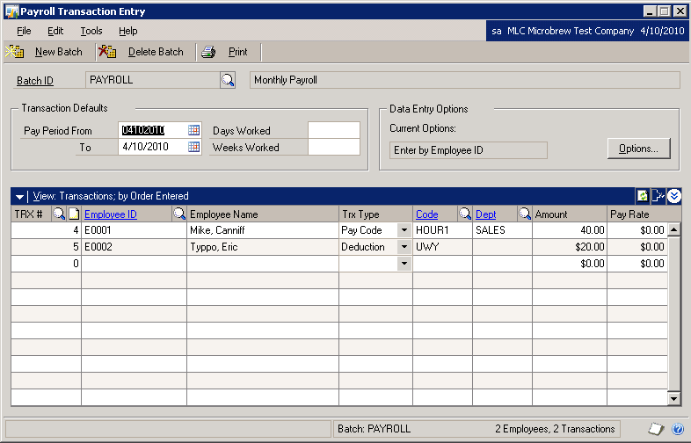
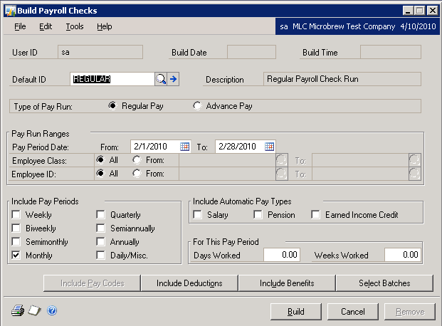
Run Payroll
Batch needs to be defined for computer checks
Build Checks to collect all transactions for the period
Enter the transaction values – note the different types

Slide 24
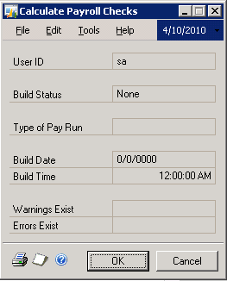
Print Checks
Run Pre-Check Report
  Verify All Calculations
  Required Step before printing
Print Checks
  Students get to see basic payroll check
  Upon exiting report, results will be posted to Payroll subsidiary ledger
Perform a Series Post to GL

Slide 25
Topics
Background and Motivation
Curriculum Details
  Business Process Pedagogy
  GP Requirements
Future Enhancements

Slide 26
Lessons Learned
Payroll Module
  Should Really be Integrated with Time and Attendance
  Entering transactions is too simplified
  After completing setup, payroll execution is relatively straightforward
Human Resource Module
  Not required to demonstrate impact on GL
  Would be useful, if faculty desires to use in an HRMS class

Slide 27
Plans for Next Year
Include Deductions
  State Taxes
  Benefits or other Deductions (United Way)
Employee Hours
  Create Multiple transactions for different types of hours
  Possible Overtime
Highlight GL Transaction Flows for New Data
Reduce Setup Requirements

Slide 28

Questions???
© 2010 Microsoft Corporation. All rights reserved. Microsoft, Windows, Windows Vista and other product names are or may be registered trademarks and/or trademarks in the U.S. and/or other countries.
The information herein is for informational purposes only and represents the current view of Microsoft Corporation as of the date of this presentation. Because Microsoft must respond to changing market conditions, it should not be interpreted to be a commitment on the part of Microsoft, and Microsoft cannot guarantee the accuracy of any information provided after the date of this presentation.
MICROSOFT MAKES NO WARRANTIES, EXPRESS, IMPLIED OR STATUTORY, AS TO THE INFORMATION IN THIS PRESENTATION.

