Slide 2
Dynamics as a Teaching and Learning Tool:
Microsoft Dynamics Academic Preconference
The First Step—Restructuring the AIS Course
Richard L Banham, JD, PhD, CPA
Associate Professor
Accounting and Law
Tennessee State University

Slide 3
Failing to Learn from the Past
What does the history of software in the University teach us?
What is the general perception of teaching software in university/college courses?
What can we learn by examining the history of office products?
How are ERP systems utilized today?
Are there other possible uses beyond teaching only the software?

Slide 4
ERP as Teaching and Learning Tool
How does teaching the concept differ from teaching the software?
What can ERP software augment accounting principles and practices?
How can meaningful change be implemented?
Research on AIS Curriculum Development
Model for Evaluating AIS Curriculum
Uses as a teaching concept, current and future
Barriers to implementing
Methods of overcoming barriers

Slide 5
Research on AIS Curriculum
Badua (2008) Google Search of course syllabi
Premise representative sample
Based on frequency of access
Findings
Topics listed eight in 2001 to thirty nine in 2007
Frequency analysis -cycles/processes, controls, Microsoft Access, REA, DBMS, flow charts, Great Plains, DFDs, and e-commerce
Results: Current view of what AIS faculty believe are important topics

Slide 6
Research on AIS Curriculum (cont.)
(Dillon & Kruck, 2008) Specialized AIS Degree Programs
Survey of professions covers 56 topics taught in degree program
Eight topics significantly more important
only one on professors’ list cycles/processes.
other seven: financial statements, accounting cycles, auditing, documentation skills (work papers), GAAP, and spreadsheets
Result: Professor’s views not in-sink with CPA practice and consulting professionals

Slide 7
Research on AIS Curriculum (cont.)
Bradford, Richtermeyer, & Roberts, 2007
IMA sample not practice but business oriented with 45% Controllers or Asst. Controllers
Focus on Systems Flowcharts, Data Flow Diagrams, E-R Diagrams, REA Models, Process Maps, and UML.
Reasons for using flowcharts:
79 percent of professionals describe business processes
86 percent of professors evaluate a system
47 percent of the texts evaluate internal controls
Results: Reasons for teaching diagramming are not uniform

Slide 8
Research on AIS Curriculum (cont.)
Andrews and Wynekoop, 2004
Model developed for MIS Curriculum by professional organizations
CPA Vision Project
IFA Information Systems Plan
Phone survey of professionals delineates skills needed by new hires

Slide 9
Model Prior to Survey
What
Impacts /
Interrelations
Usage / Product
Systems Design
Information Systems Risks
Technological /
Operational
Risks and Controls
Transaction Processing
Synthesis/Design
/ Evaluation
Risk/Security
How
Analysis
/Application
Comprehension/
Remembering

Slide 10
Final Model
Assess Risk of
Technology
What
Impacts /
Interrelations
Use technology to assess & control risk
Usage / Product
Technological /
Operational
Identify Risk
Synthesis/Design
/ Evaluation
Evaluate Databases
How
Analysis
/Application
Develop Databases
Comprehension/
Remembering
Understand Databases
Design Business Applications
Use Software Packages
Understand Knowledge

Slide 11
Implications and Value of Model
Two Dimensional View of Curriculum
Expanding the Level of Learning critical to curriculum development
Viewing curriculum from 3 technology acquisition levels heightens the complexity of the curriculum
Result: Curriculum change in a technology based profession requires a new prospective for both facilitators and students

Slide 12
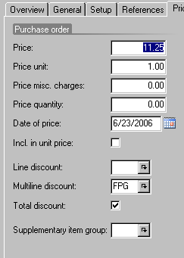
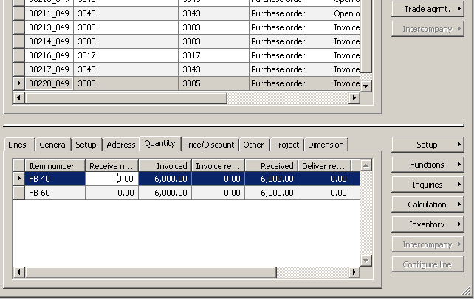
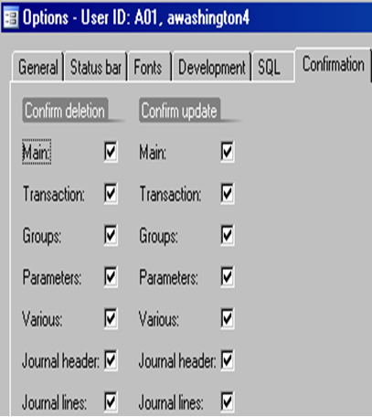
Dynamics AX Examples
Why AX not GP
Initial Project
Business Cycles
Trade vs. Sales Discounts
Illustrate Value of Controls Early in the Course

Slide 13
Dynamics AX Examples (cont.)
Evaluating AX’s Internal Controls
Undergraduate Class
Graduate Class
Chart of Accounts Exercise
Programming
Fordham, 2005
Product Builder Exercise
Project Module and SharePoint
XBRL and Financial Reporting

Slide 14
Barriers to Expanding Usage
Divide Barriers, 2 Groups
Internal
External
Each Group, 4 Barriers
Internal
Time
Aptitude
Skills
Desire
External
Academic Atmosphere
Training
Risk/Reward Time
Technical Resources

Slide 15
Internal Barriers
Time
Issues
Academic/Workplace vs. Personal
Aptitude
Faculty Familiarity and Comfort with Technology
Early adopters of Lotus/Excel

Slide 16
Internal Barriers (cont.)
Skills
Aptitude sets baseline
Comfort Level in front of students
Time is underlying constraint
Desire
Realization that a current reallocation of time will result in greater benefits in the future
Either the greatest tool or largest barrier

Slide 17
External Barriers Academic Atmosphere
Counter-balances Desire
AACSB Issues
Recent Monetary Pressure
Increase class size
Raised standard for reduced teaching load
Publishing pressure not diminishing

Slide 18
External Barriers (cont.)
Training
Load issue
On-line Tools
Provide general training
Limit focus on a specific process
Loss of access to Dynamics Training Manuals
Risk Reward
Time, atmosphere, and internal constrains dictate

Slide 19
External Barriers (cont.) Technology
Status of Efforts to Address
VP image
Partner Program
Loss of Terminal Services
Breaching the Firewall

Slide 20
Possible Solutions Discussion Forum
Recognize that DYNAAA has been active in working to provide solutions
Discuss alternative proposals
Based on personal experiences

Slide 21
Academic Atmosphere
Decision to publish proceedings
Facilitate joint research projects
Support research studies –
Encourage User Groups, VAR’s, and Customers
Types of Research
Knowledge and curriculum
Compliance, controls, and monitoring.
Delineation of ERP issues outside AIS area.
Academic and Professional Journal
User groups and MSDN Alliance
Editorial Board of academics and technical reviewers – Best Papers Issue

Slide 22
Training
Necessary Training Materials
CD format materials
Certified Training Program (alternative)
Documentation tool for teaching

Slide 23
Technical Issues
SharePoint Issue
Dynamics reliance on Software
MSDN Membership Solution
Available to departments for a yearly fee
Downloads of any licensed product available to students
Use Visio in AIS Course for diagramming
State support and Hardware Needs
Academic Configuration based on Users/Product
Server Specifications
Configuration Specifications
Mentoring Program
Grant Program Established

Slide 24
Risk/ Reward Time Barrier
DYNAA Newsletter
Highlight innovative use of Dynamics products
Distribute newsletter to Department Heads
Establish “Partner Needed” column
User Groups
Provide insight into issues
Connect with CFO’s and others in accounting
Remove financial barrier of $400/year
Change selection process, Advisory Board

Slide 25
Would your students benefit from any of these changes? How can I help you implement your any changes? Please contact me any time!

